Slide 1

Agent Activity Chart
6/23/2023 4:13 AM
Print User : mobile
Page 1 of 3

Slide 2
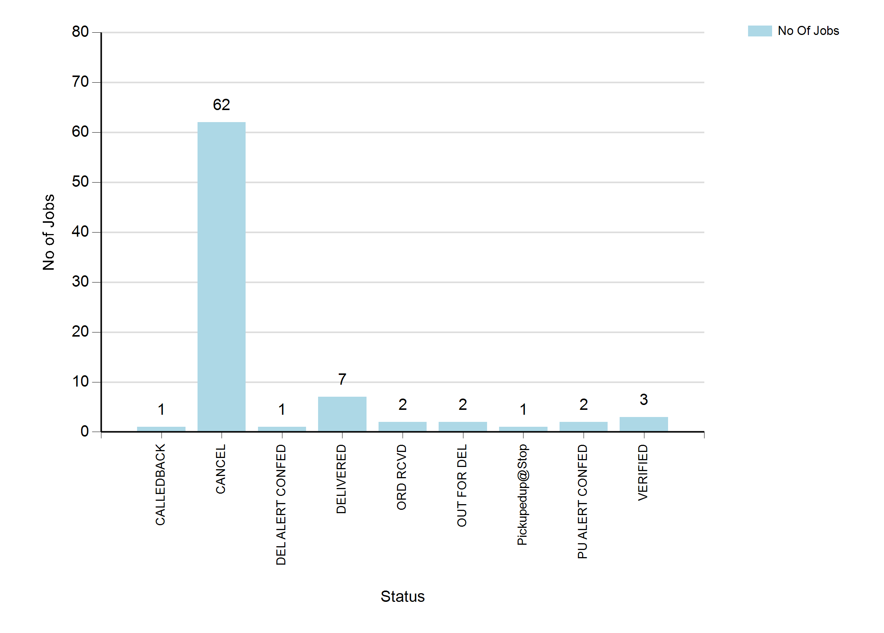
6/23/2023 4:13 AM
Print User : mobile
Page 2 of 3

Slide 3
6/23/2023 4:13 AM
Print User : mobile
Page 3 of 3

